Slide 1
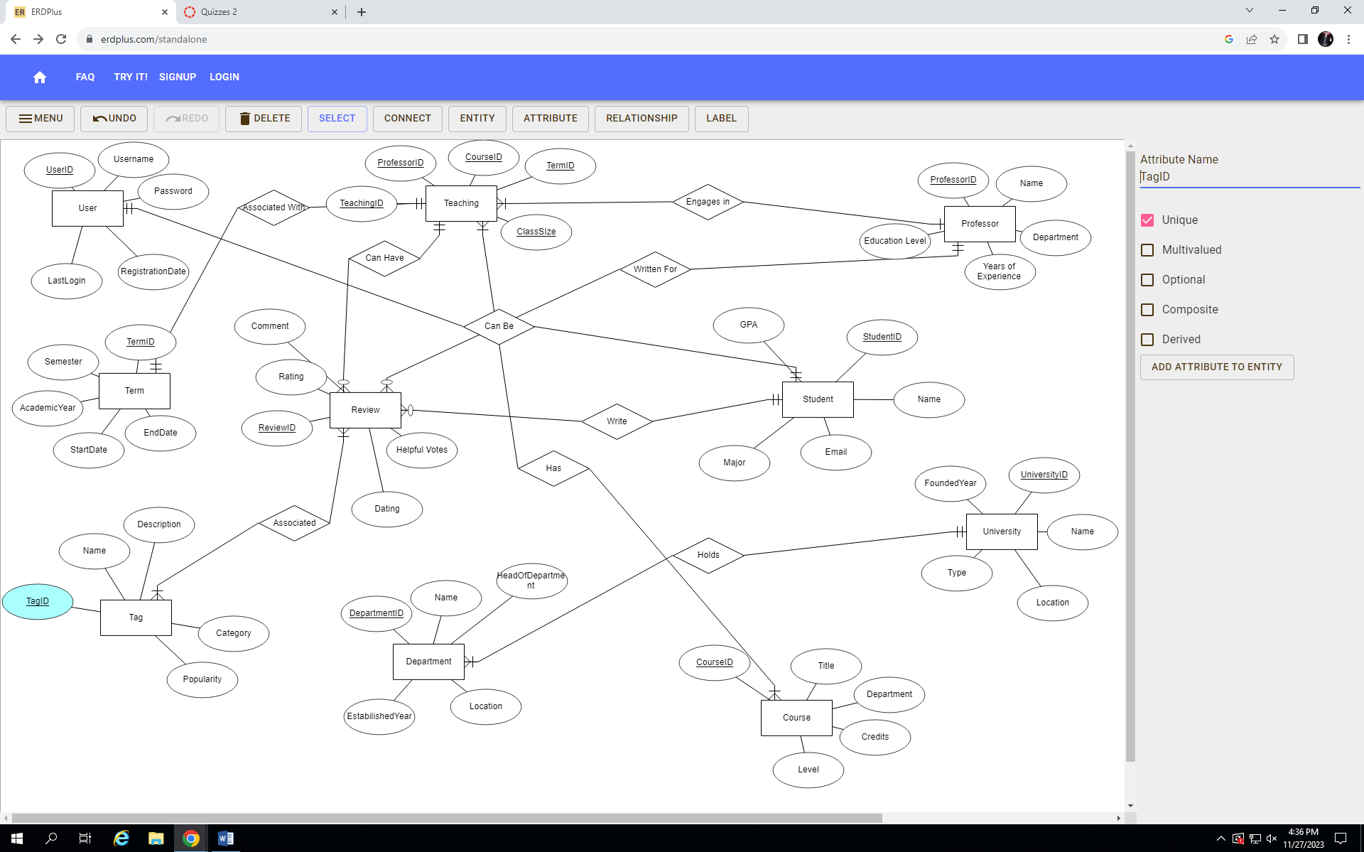
ProfessIt - Teacher rating software - AMAN GILL
Conceptualized data model with regards to cardinalities, attributes, and relationships
Presented model in Relational format and established foreign key relationships
Utilized models to help create database and tables in SSMS
Populated created tables with corresponding data for attributes
Executed diagram on SSMS in order to showcase Physical Model
Created new database and utilized ETL to transfer from Original
Implemented PowerBI to present a simple visualization of Data
Navigated necessary phases in order to fully design database
Overall This Project has enabled me to exercise the set of skills, and comprehension of software needed to design the structure of a database from start to finish

